Slide 1
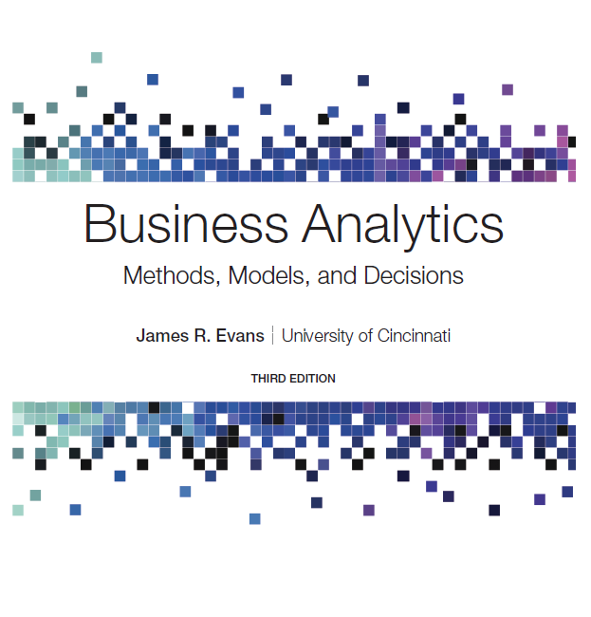
Business Analytics: Methods, Models, and Decisions
Third Edition
Chapter 6
Sampling and Estimation
Copyright © 2020, 2016, 2013 Pearson Education, Inc. All Rights Reserved
Notes:
If this PowerPoint presentation contains mathematical equations, you may need to check that your computer has the following installed:
1) MathType Plugin
2) Math Player (free versions available)
3) NVDA Reader (free versions available)

Slide 2
Statistical Sampling
Sampling is the foundation of statistical analysis.
Sampling plan - a description of the approach that is used to obtain samples from a population prior to any data collection activity.
A sampling plan states:
its objectives
target population
population frame (the list from which the sample is selected)
operational procedures for collecting data
statistical tools for data analysis

Slide 3
Example 6.1: A Sampling Plan for a Market Research Study
A company wants to understand how golfers might respond to a membership program that provides discounts at golf courses.
Objective - estimate the proportion of golfers who would join the program
Target population - golfers over 25 years old
Population frame - golfers who purchased equipment at particular stores
Operational procedures - e-mail link to survey or direct-mail questionnaire
Statistical tools - PivotTables to summarize data by demographic groups and estimate likelihood of joining the program

Slide 4
Sampling Methods
Subjective Methods
Judgment sampling - expert judgment is used to select the sample
Convenience sampling - samples are selected based on the ease with which the data can be collected
Probabilistic Sampling
Simple random sampling involves selecting items from a population so that every subset of a given size has an equal chance of being selected.

Slide 5
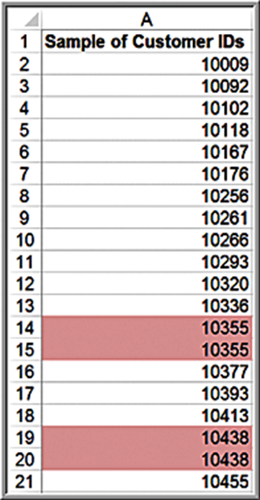
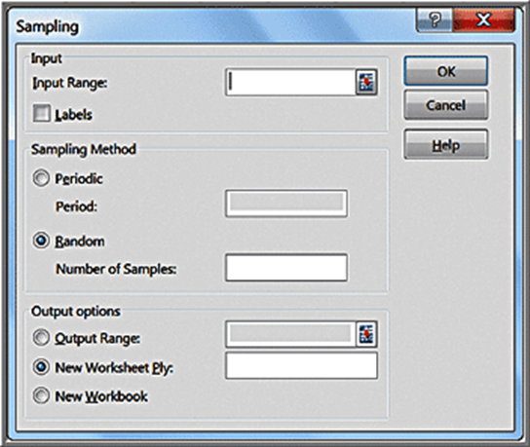
Example 6.2: Simple Random Sampling with Excel
Sales Transactions database
Periodic selects every
number
Random selects a simple random sample
Sampling is done with replacement so duplicates may occur.

Slide 6
Additional Probabilistic Sampling Methods
Systematic (periodic) sampling - a sampling plan that selects every
item from the population.
Stratified sampling - applies to populations that are divided into natural subsets (called strata) and allocates the appropriate proportion of samples to each stratum.
Cluster sampling - based on dividing a population into subgroups (clusters), sampling a set of clusters, and (usually) conducting a complete census within the clusters sampled
Sampling from a continuous process
Select a time at random; then select the next n items produced after that time.
Select n times at random; then select the next item produced after each of these times.

Slide 7
Estimating Population Parameters
Estimation involves assessing the value of an unknown population parameter using sample data.
Estimators are the measures used to estimate population parameters.
E.g., sample mean, sample variance, sample proportion
A point estimate is a single number derived from sample data that is used to estimate the value of a population parameter.

Slide 8
Unbiased Estimators
If the expected value of an estimator equals the population parameter it is intended to estimate, the estimator is said to be unbiased.
The denominator
used in computing
is
necessary to provide an unbiased estimator of

Slide 9
Sampling Error
Sampling (statistical) error occurs because samples are only a subset of the total population
Sampling error is inherent in any sampling process, and although it can be minimized, it cannot be totally avoided.
Nonsampling error occurs when the sample does not represent the target population adequately.
Nonsampling error usually results from a poor sample design or inadequate data reliability.

Slide 10
Example 6.3: A Sampling Experiment (1 of 3)
A population is uniformly distributed between 0 and 10.
Experiment:
Generate 25 samples of size 10 from this population.
Compute the mean of each sample.
Prepare a histogram of the 250 observations,
Prepare a histogram of the 25 sample means.
Repeat for larger sample sizes and draw comparative conclusions.

Slide 11
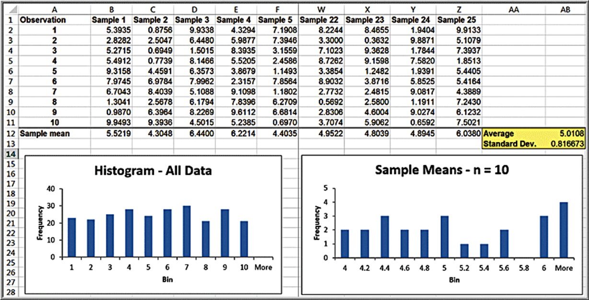
Example 6.3: A Sampling Experiment (2 of 3)
Note that the average of all the sample means is quite close the true population mean of 5.0.

Slide 12
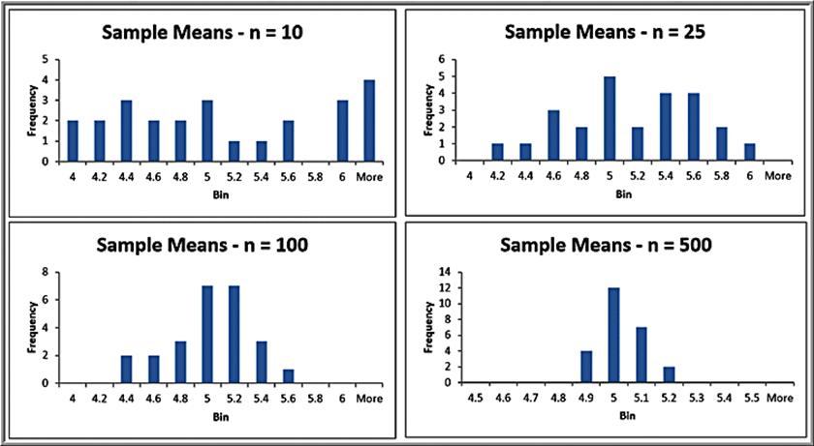
Example 6.3: A Sampling Experiment (3 of 3)
Repeat the sampling experiment for samples of size 25, 100, and 500
As the sample size increases, the average of the sample means are all still close to the expected value of 5; however, the standard deviation of the sample means becomes smaller, meaning that the means of samples are clustered closer together around the true expected value. The distributions become normal.
Sample Size | Average of 25 Sample Means | Standard Deviation of 25 Sample Means
10 | 5.0108 | 0.816673
25 | 5.0779 | 0.451351
100 | 4.9173 | 0.301941
500 | 4.9754 | 0.078993

Slide 13
Example 6.4: Estimating Sampling Error Using the Empirical Rules
Using the empirical rule for 3 standard deviations
away from the mean,
of sample means
should be between:
Sample Size | Average of 25 Sample Means | Standard Deviation of 25 Sample Means
10 | 5.0108 | 0.816673
25 | 5.0779 | 0.451351
100 | 4.9173 | 0.301941
500 | 4.9754 | 0.078993
As the sample size increases, the sampling error decreases.

Slide 14
Sampling Distributions
The sampling distribution of the mean is the distribution of the means of all possible samples of a fixed size n from some population.
The standard deviation of the sampling distribution of the mean is called the standard error of the mean:
As n increases, the standard error decreases.
Larger sample sizes have less sampling error.

Slide 15
Example 6.5: Computing the Standard Error of the Mean
For the uniformly distributed population, we found
Sample Size, n | Standard Error of the Mean
10 | 0.914
25 | 0.5778
100 | 0.289
500 | 0.129

Slide 16
Central Limit Theorem
If the sample size is large enough, then the sampling distribution of the mean is:
approximately normally distributed regardless of the distribution of the population
has a mean equal to the population mean.
If the population is normally distributed, then the sampling distribution is also normally distributed for any sample size.
The central limit theorem allows us to use the theory we learned about calculating probabilities for normal distributions to draw conclusions about sample means.

Slide 17
Applying the Sampling Distribution of the Mean
The key to applying sampling distribution of the mean correctly is to understand whether the probability that you wish to compute relates to an individual observation or to the mean of a sample.
If it relates to the mean of a sample, then you must use the sampling distribution of the mean, whose standard deviation is the standard error, not the standard deviation of the population.

Slide 18
Example 6.6: Using the Standard Error in Probability Calculations
The purchase order amounts for books on a publisher’s Web site is normally distributed with a mean of $36 and a standard deviation of $8.
Find the probability that:
a) someone’s purchase amount exceeds $40.
Use the population standard deviation:
b) the mean purchase amount for 16 customers exceeds $40.
Use the standard error of the mean:

Slide 19
Interval Estimates
An interval estimate provides a range for a population characteristic based on a sample.
Intervals specify a range of plausible values for the characteristic of interest and a way of assessing “how plausible” they are.
In general, a
probability interval is any interval
such that the probability of falling between A and B is
Probability intervals are often centered on the mean or median.
Example: in a normal distribution, the mean plus or minus 1 standard deviation describes an approximate 68% probability interval around the mean.

Slide 20
Example 6.7: Interval Estimates in the News
A Gallup poll might report that 56% of voters support a certain candidate with a margin of error of
We would have a lot of confidence that the candidate
would win since the interval estimate is
Suppose the poll reported a 52% level of support with a
margin of error.
We would be less confident in predicting a win for the candidate since the interval estimate is

Slide 21
Confidence Intervals
A confidence interval is a range of values between which the value of the population parameter is believed to be, along with a probability that the interval correctly estimates the true (unknown) population parameter.
This probability is called the level of confidence, denoted by
is a number between 0 and 1.
The level of confidence is usually expressed as a percent; common values are 90%, 95%, or 99%.
For a 95% confidence interval, if we chose 100 different samples, leading to 100 different interval estimates, we would expect that 95% of them would contain the true population mean.

Slide 22
Confidence Interval for the Mean with Known Population Standard Deviation
Sample mean
margin of error
Margin of error is:
(standard error)
is the value of the standard normal random variable for an upper tail
area of
(or a lower tail area of
Example: if
(for a 95% confidence interval), then
Example: if
(for a 90% confidence interval), then
The margin of error can also be computed by

Slide 23
Example 6.8: Computing a Confidence Interval with a Known Standard Deviation
A production process fills bottles of liquid detergent. The standard deviation in filling volumes is constant at 15 milliliters. A sample of 25 bottles revealed a mean filling volume of 796 milliliters.
A 95% confidence interval estimate of the mean filling volume for the population is

Slide 24
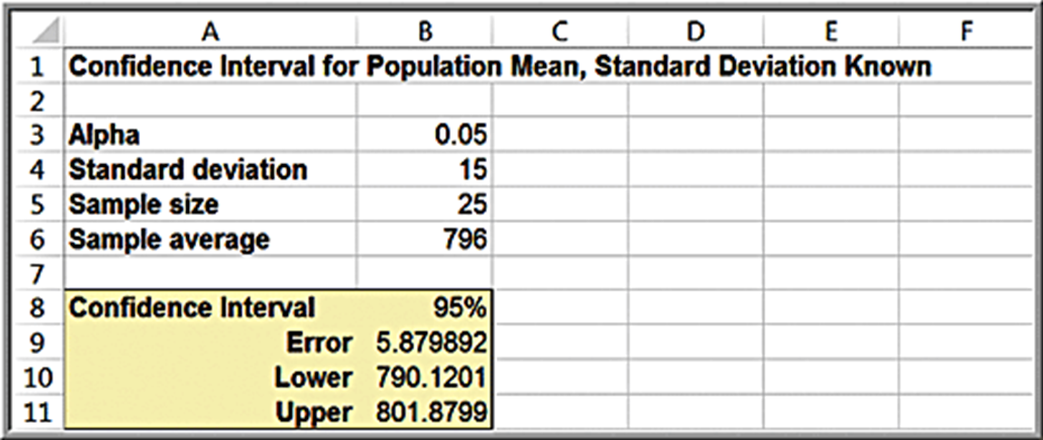
Excel Workbook for Confidence Intervals
The worksheet Population Mean Sigma Known in the Excel workbook Confidence Intervals computes this interval using the C O N F I D E N C E.N O R M function.

Slide 25
Confidence Interval Properties
As the level of confidence,
decreases,
decreases, and the confidence interval becomes narrower.
For example, a 90% confidence interval will be narrower than a 95% confidence interval. Similarly, a 99% confidence interval will be wider than a 95% confidence interval.
Essentially, you must trade off a higher level of accuracy with the risk that the confidence interval does not contain the true mean.
To reduce the risk, you should consider increasing the sample size.

Slide 26
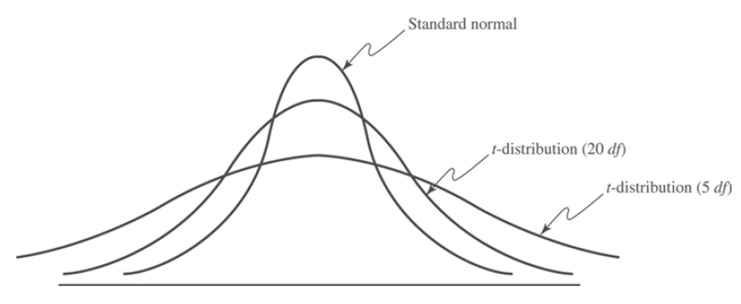
The t-Distribution
The t-distribution is a family of probability distributions with a shape similar to the standard normal distribution. Different t-distributions are distinguished by an additional parameter, degrees of freedom (d f).
As the number of degrees of freedom increases, the t-distribution converges to the standard normal distribution

Slide 27
Confidence Interval for the Mean with Unknown Population Standard Deviation
where
is the value of the t-distribution with
for an upper tail area of
t values are found in Table 2 of Appendix A or with the Excel function
The Excel function
can be used to compute the margin of error

Slide 28
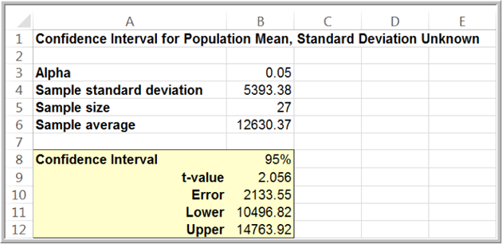
Example 6.9: Computing a Confidence Interval with Unknown Standard Deviation
Excel file Credit Approval Decisions. Find a 95% confidence interval estimate of the mean revolving balance of homeowner applicants (first, sort the data by homeowner).
Sample mean = $12,630.37; s = $5393.38; standard error = $1037.96;

Slide 29
Confidence Interval for a Proportion
An unbiased estimator of a population proportion
(this is not the number
is the statistic
(the sample proportion), where x is the number
in the sample having the desired characteristic and n is the sample size.
A
confidence interval for the proportion is

Slide 30
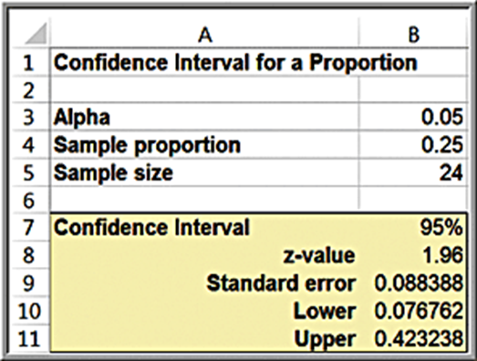
Example 6.10: Computing a Confidence Interval for a Proportion
Excel file Insurance Survey. We are interested in the proportion of individuals who would be willing to pay a lower premium for a higher deductible for their health insurance.
Confidence interval:

Slide 31
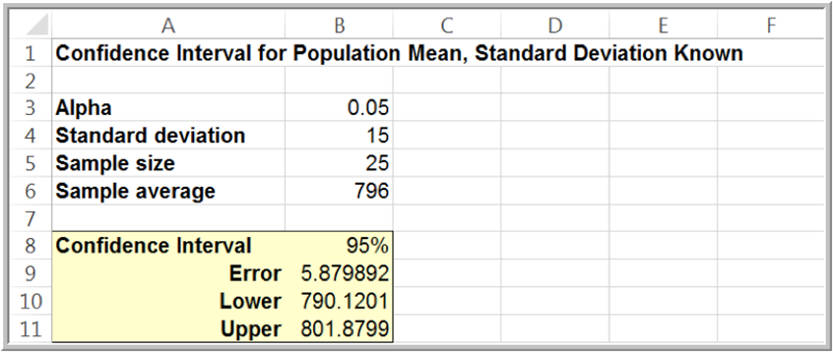
Example 6.11: Drawing a Conclusion About a Population Mean Using a Confidence Interval
In Example 6.8, the required volume for the bottle-filling process is 800 and the sample mean is 796 milliliters. We obtained a confidence interval
Should machine adjustments be made?
Although the sample mean is less than 800, the sample does not provide sufficient evidence to draw that conclusion that the population mean is less than 800 because 800 is contained within the confidence interval.

Slide 32
Example 6.12: Using a Confidence Interval to Predict Election Returns
An exit poll of 1,300 voters found that 692 voted for a particular candidate in a two-person race. This represents a proportion of 53.23% of the sample. Could we conclude that the candidate will likely win the election?
A 95% confidence interval for the proportion is
This suggests that the population proportion of voters who favor this candidate is highly likely to exceed 50%, so it is safe to predict the winner.
If the sample proportion is 0.515,the confidence interval for the population
proportion is
Even though the sample proportion is larger than
50%, the sampling error is large, and the confidence interval suggests that it is reasonably likely that the true population proportion could be less than 50%, so you cannot predict the winner.

Slide 33
Data Visualization for Confidence Intervals
We may use an Excel stock chart to visualize confidence intervals easily (the stock chart requires that you have at least three variables).
This is particularly useful for comparing confidence intervals for different groups.

Slide 34
Example 6.13: Creating a Stock Chart for Confidence Intervals (1 of 3)
Suppose that we constructed confidence intervals for monthly credit card debt for a sample of banking customers in four age groups.
Age Group | Upper C l | Lower C l | Mean
25-34 | $2,103 | $711 | $1,407.14
35-44 | $1,617 | $872 | $1,244.44
45-54 | $1,114 | $468 | $ 791.30
55-64 | $1,931 | $309 | $1,120.00
The columns should correspond to the variable name, upper C I limit, lower C I limit, and mean, in that order.

Slide 35
Example 6.13: Creating a Stock Chart for Confidence Intervals (2 of 3)
Next, highlight the range of this table and insert an Excel High-Low-Close Stock Chart. Right-click one of the confidence intervals in the chart and choose Format
In the dropdown menu for High-Low
Line Options, choose one of the series (Upper C I, Lower C I, or Mean) to format the markers.
In the Format Data Series pane, click the paint icon and then Marker, making sure to expand the Marker Options menu. Choose the type of marker you wish and increase the width of the markers to make them more visible.

Slide 36
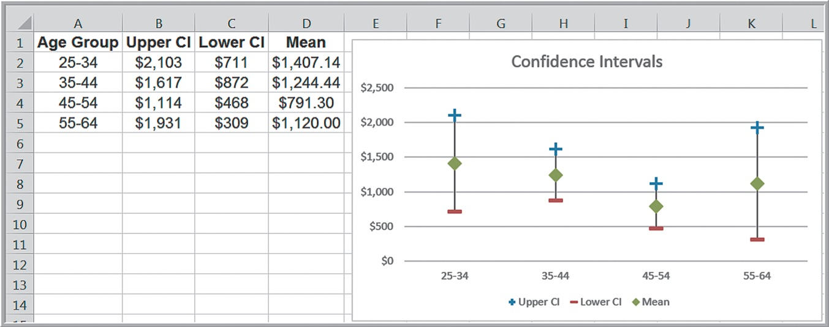
Example 6.13: Creating a Stock Chart for Confidence Intervals (3 of 3)

Slide 37
Prediction Intervals
A prediction interval is one that provides a range for predicting the value of a new observation from the same population.
A confidence interval is associated with the sampling distribution of a statistic, but a prediction interval is associated with the distribution of the random variable itself.
A
prediction interval for a new observation is

Slide 38
Example 6.14: Computing a Prediction Interval
Compute a 95% prediction interval for the revolving balances of customers (Credit Approval Decisions)

Slide 39
Confidence Intervals and Sample Size
We can determine the appropriate sample size needed to estimate the
population parameter within a specified level of precision
Sample size for the mean:
Sample size for the proportion:
Use the sample proportion from a preliminary sample as an
estimate of
or set p = 0.5 for a conservative estimate to
guarantee the required precision.

Slide 40
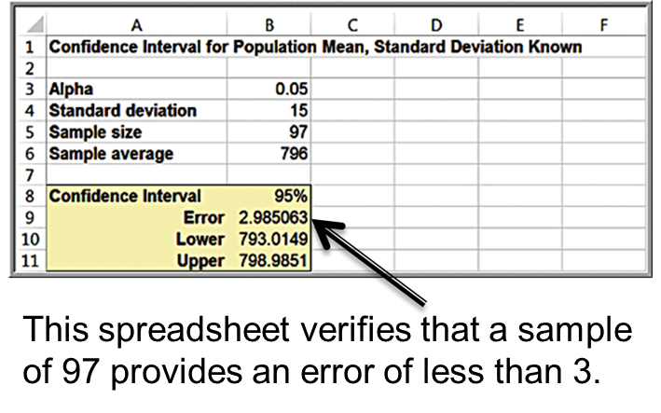
Example 6.15: Sample Size Determination for the Mean
In Example 6.8, the sampling error was
What sample size is needed to reduce the margin of error to at most 3 milliliters?
Round up to 97 samples.

Slide 41
Example 6.16: Sample-Size Determination for a Proportion
For the voting example we discussed, suppose that we wish to determine the number of voters to
poll to ensure a sampling error of at most
With no information, use

